Slide 1
Mcp Rearrange 6 x 4 vs 5 x 4 vs 4 x4
For geometric reconstruction = 4000 events
For time imaging reconstruction = 50000 events

Slide 2
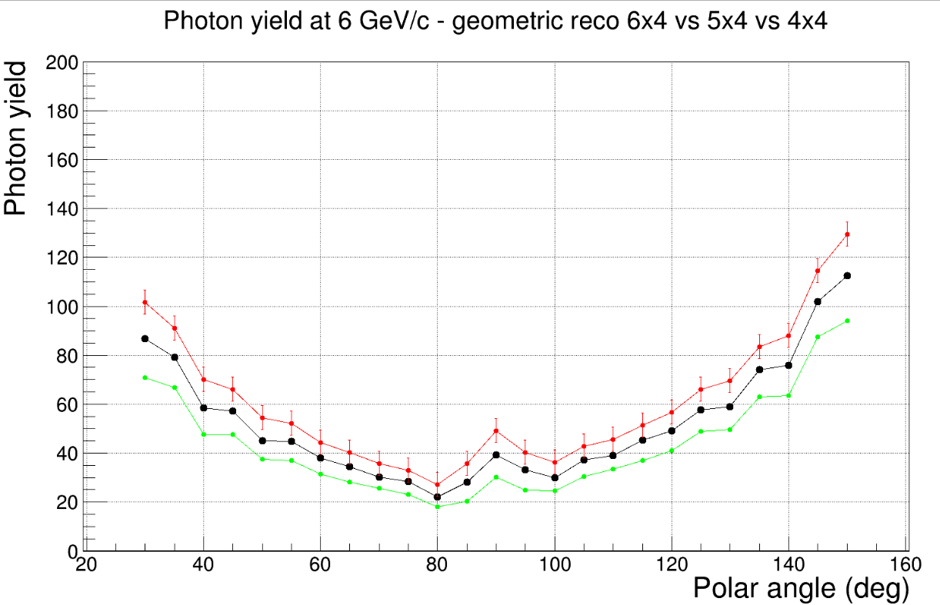
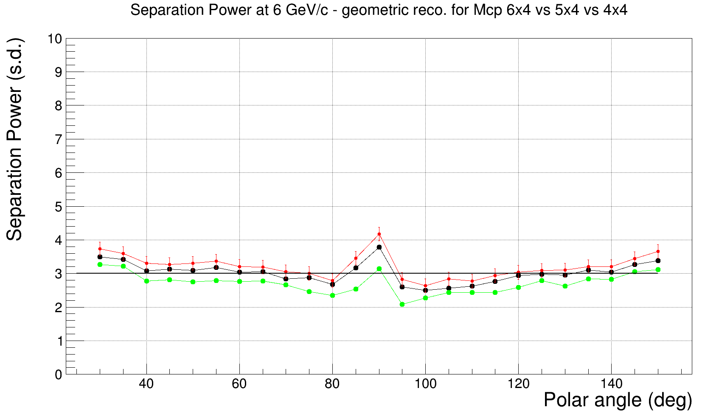
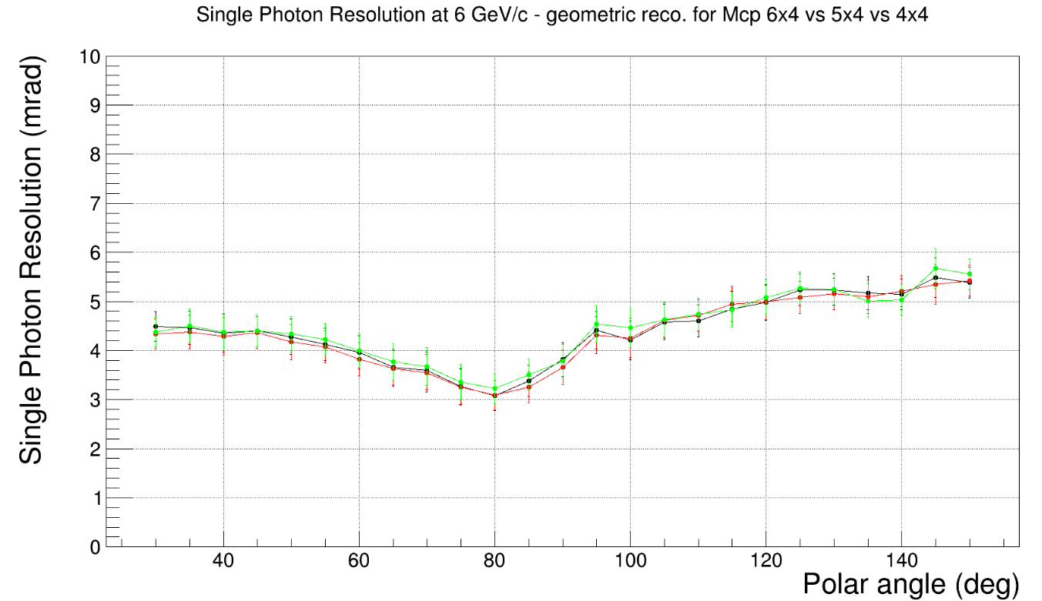
Mcp 6 x 4
Mcp 5 x 4
Mcp 4 x4

Slide 3
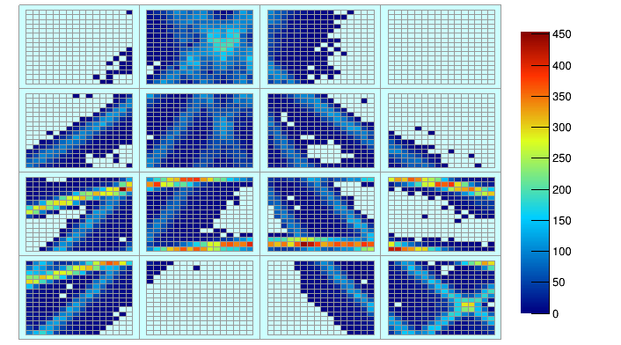
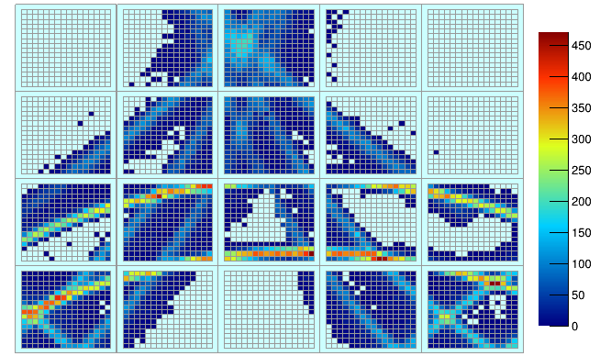
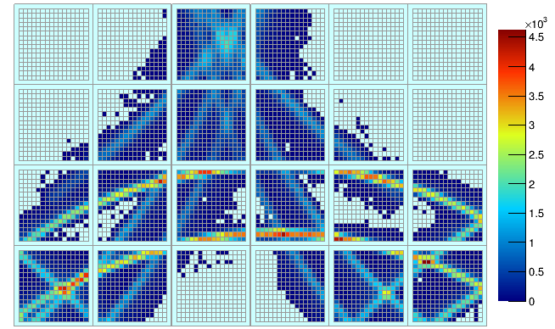
Hp for Mcp 4 x 4
Hp for Mcp 5 x 4
Hp for Mcp 6 x 4

Slide 4
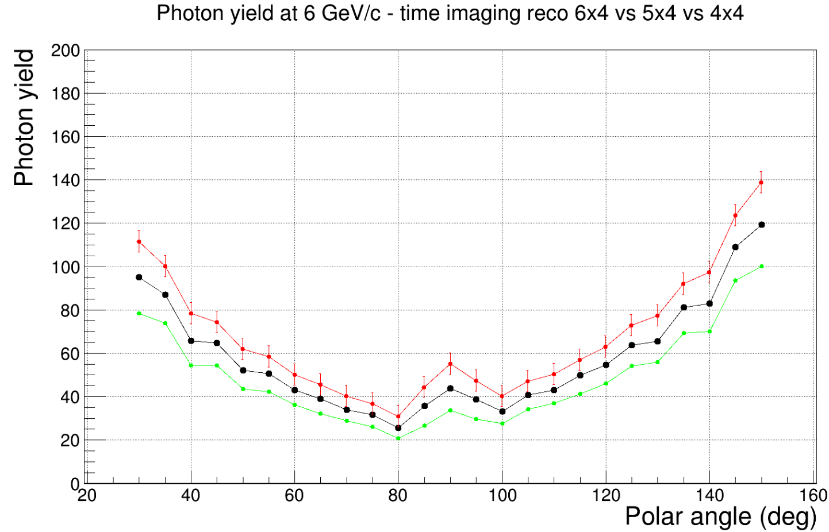
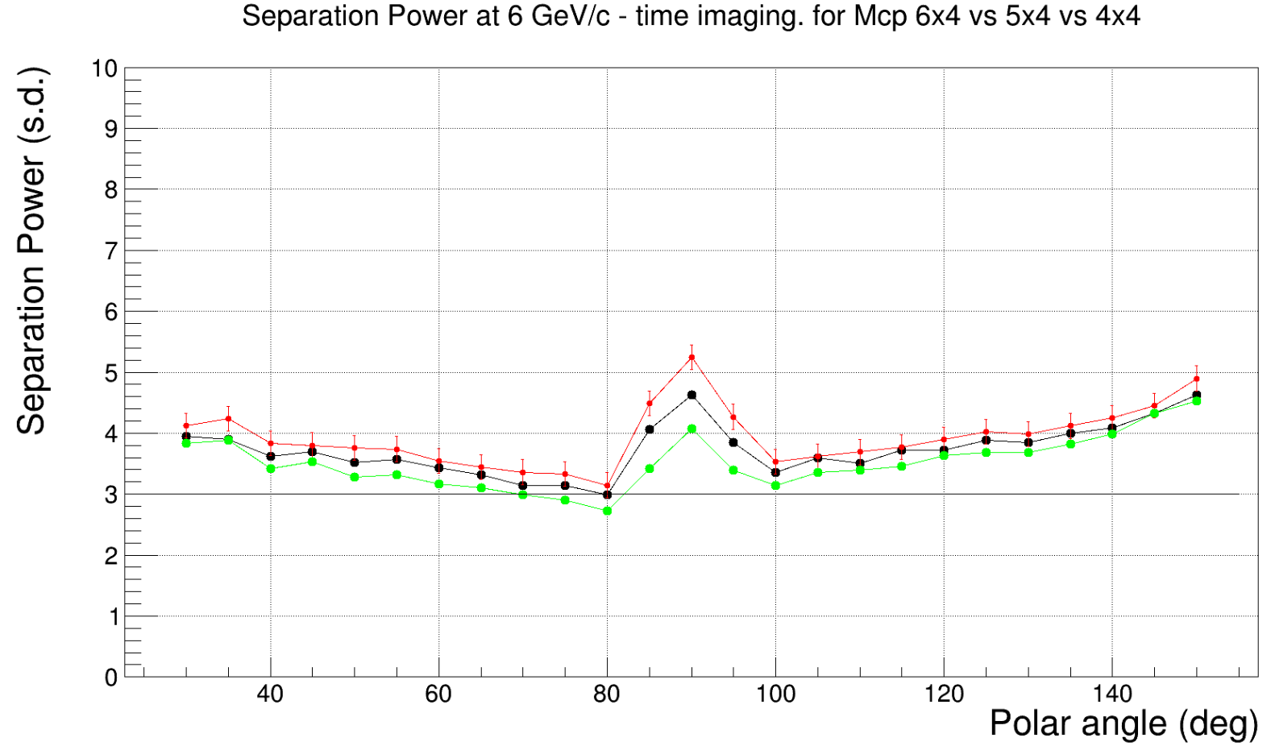
Mcp- 6x4
Mcp- 6x4
Mcp- 6x4

Slide 5
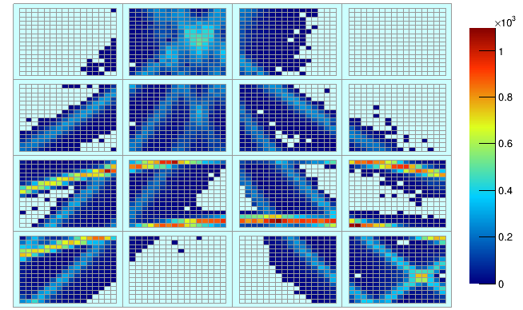
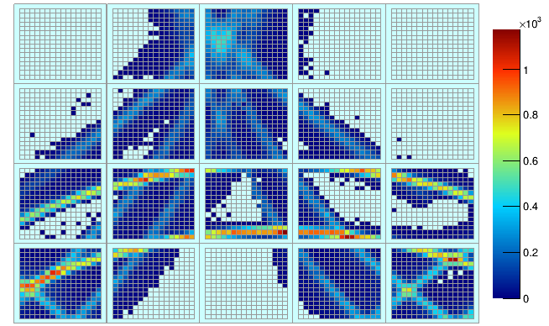
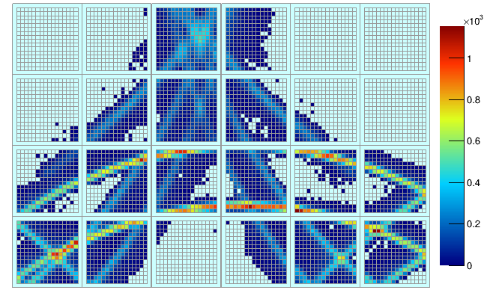
Hp for Mcp 4 x 4
Hp for Mcp 5 x 4
Hp for Mcp 6 x 4

